Slide 1





Enhancing Banking Efficiency with Generative AI
Generative AI is revolutionizing the banking industry, empowering financial institutions to streamline operations and enhance customer experiences. This presentation explores how banks can leverage this transformative technology to optimize workflows and boost overall efficiency.
by GOUTHAM NAYAK

Slide 2


The Challenge: Improving Operational Efficiency in Banking
1
Automating Repetitive Tasks
Banks face the challenge of streamlining manual, time-consuming processes to free up employee time and resources.
2
Optimizing Workflows
Identifying and addressing inefficiencies in banking workflows can lead to significant productivity gains.
3
Enhancing Customer Experience
Improving operational efficiency enables banks to provide faster, more personalized service to their customers.

Slide 3
Generative AI: A Transformative Technology
Natural Language Processing
Computer Vision
Process Optimization
Generative AI excels at processing and generating human-like text, enabling intelligent automation of tasks such as customer support and document creation.
Generative AI can analyze and generate images, revolutionizing visual-based processes like fraud detection and document processing.
By identifying patterns and optimizing workflows, generative AI can streamline banking operations and enhance overall efficiency.

Slide 4


Automating Routine Tasks with Generative AI
1
Data Entry
Generative AI can automate the process of inputting customer information and transaction details, reducing errors and increasing speed.
2
Report Generation
Generative AI can generate comprehensive reports, summaries, and analyses, freeing up employees to focus on higher-value tasks.
3
Customer Support
Chatbots powered by generative AI can handle routine customer inquiries, improving response times and customer satisfaction.

Slide 5


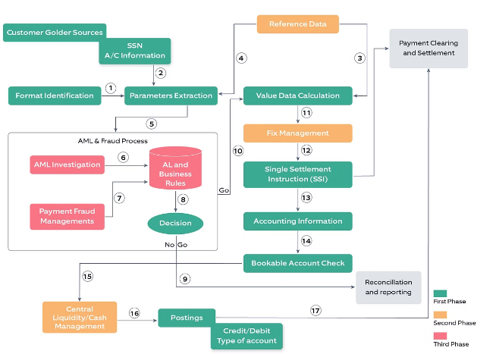


Optimizing Workflows and Processes
Identify Inefficiencies
Generative AI can analyze banking processes and workflows to uncover areas of improvement.
Streamline Processes
Banks can leverage generative AI to automate and optimize repetitive tasks, reducing processing times and errors.
Enhance Decision-Making
Generative AI can provide data-driven insights to help banks make informed decisions and improve overall efficiency.

Slide 6





Enhancing Customer Experience
Faster Service
Generative AI-powered automation reduces waiting times and improves the overall customer experience.
Personalized Interactions
Generative AI can analyze customer data to provide tailored recommendations and solutions, fostering deeper connections.
Accurate Responses
Generative AI chatbots and virtual assistants can provide consistent, reliable information to customers.

Slide 7


Ensuring Data Security and Compliance
Secure Data Processing
Generative AI can be trained to handle sensitive customer data in compliance with regulatory requirements.
Fraud Detection
Generative AI can analyze transaction patterns to identify and flag potential fraudulent activities, enhancing security.
Compliance Reporting
Generative AI can automate the generation of regulatory reports, ensuring accurate and timely submissions.

Slide 8


Conclusion: Embracing the Future of Banking
1
Unlocking Efficiency Gains
By integrating generative AI, banks can streamline operations, reduce costs, and free up resources to focus on strategic initiatives.
2
Enhancing Customer Experience
Generative AI enables banks to provide faster, more personalized, and more accurate services, improving customer satisfaction and loyalty.
3
Securing the Future
Embracing generative AI technology positions banks to stay ahead of the curve, ensuring compliance and safeguarding data in the digital age.

